Slide 1


Smart Start
Are you ready to become
a small business owner?
Presented by
Iowa Small Business Development Centers and the
SBA

Slide 2


Funded in part through a cooperative agreement with the
U.S. Small Business Administration

Slide 3
What is a Small Business?
A small business generally has
500 employees or less
and/or
$6 million in sales or less.
As defined by the U.S. Government
Notes:
Specific Industry Standards: Manufacturing —500 to 1,500. Wholesaling — up to100 employees
Services — 4.5 million to $35.5 million average annual sales. Retailing —$7 million to $35.5 m sales
General construction —$7 million to $33.5 million in sales. Agri $750,000 to $17.5 million in sales
IOWA
Small Business Makes BIG Impact!
99.7 percent of all employer firms.
50% of total private sector employees.
43% of total U.S. private payroll.
65% of net new jobs since 1995.
Over 50% of the nonfarm private GDP.
97.5% of identified exporters
43% of high tech workers.
52% home-based and 2% franchises.

Slide 4
Business Services that Support a Small Business
SBDC / SCORE
Accounting & Bookkeeping
Insurance Agent
Banker
Legal Counsel
Page 15-16

Slide 5
Start-up Basics
What personal characteristics
does it take to succeed as a small business owner?
© Iowa SBDC
Notes:
GROUP DISCUSSION and INPUT
Use FLIP CHART
Self Starter
Decision Making Skills
Being a Leader
Long Hours
Organization
Communication Skills
Strong Drive
Etc. etc.
Perseverance
Determination
Positive attitude
Etc. etc
PLANNING!!

Slide 6
Start Up Basics
Why Do Businesses Fail?
© Iowa SBDC
Notes:
GROUP DISCUSSION—FLIP CHART
Lack of experience
Insufficient Working Capital
Poor Location
Over Investment vs. Bootstrapping
Under capitalized
Poor Credit arrangements
Unexpected Growth
Competition
Low Sales
Personal Use of Business Funds
Etc. etc.
LACK OF PLANNING!!!

Slide 7

Feasibility Checklist
Market Analysis
  Customer Base
  Competition
  Sales
  Supply
  Expenses
  Miscellaneous
  Venture Feasibility
Page 27-30

Slide 8
Market Research
HOW CAN YOU CONDUCT MARKET RESEARCH?
    Direct (first hand)
      Your experience
      Who do you know in the industry
      Potential customers
      Similar businesses
      Suppliers, vendors, bankers
      Surveys/interviews/etc.
    Other resources: SBDC, Trade Associations, Economic Forecasts, Websites
© Iowa SBDC
Notes:
Cover quickly….Point is there are lots of valid sources to assess your competition.

Slide 9
Market Research
MARKET RESEARCH RESOURCES
1. Business Data and Statistics from SBA.gov
2. The U.S. Census Bureau
3. FedStats.gov
4. Small Business Statistics
5. EconomicIndicators.gov
6. Visit SBA’s Conducting Market Research for tips to use this and other data.
© Iowa SBDC
Notes:
Cover quickly….Point is there are lots of valid sources to assess your competition.

Slide 10
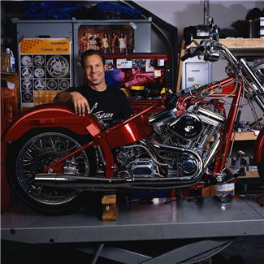
What EVERY Small Business Owner Needs to Know
What am I selling?
Product/service?
Unique how?
What’s the experience?
Why me rather than
my competitor?
© Iowa SBDC
Notes:
Exchange of product/service is a transaction.
Customer loyalty is built on an experience. Think of a place you love to go/hangout. A restaurant, store, club, salon. I bet there is a person there that you look forward to seeing…that person creates a memorable experience for you and builds loyalty. Rather than saying let’s go to Coffee Café today, do you ever stay let’s go see Alice (the owner/server/barista that you like?) Do you have a special place you like to sit at the café? Enjoy the music they play? Love their homemade caramels?
You are responding to the experience the café offers. There are lots of places to buy pretty good coffee, but only one place gives you this experience.
What kind of experience would you expect at this motorcycle shop based on the photo graph?

Slide 11
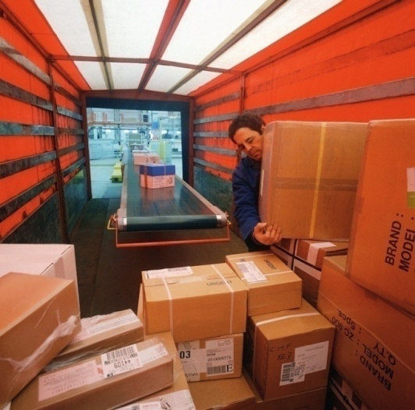
Outline of a Business Plan…
Narrative
  Who, What, When, Where, Why, and How
Financial statements
  The numbers the lender(s)and your partner or spouse want to see
        page 31

Slide 12
Narrative
Plan Summary
Company and Industry
Product or Service
Market Analysis
Market Strategy
Operations
Management &
Schedule of Activities
Critical Risks
Financial Information
Executive Summary (this will end up as the 1st page)
Page 31-36

Slide 13
Writing a Business Plan
Why Write a Business Plan?
  Communicate Idea To Others
    Forecast Profitability and Feasibility
    Determine Amount and Type of Financing
    Ensure you create a comprehensive plan
  Presentation
    No Capital Needed: Internal/Informal plan
    Capital Needed: Formal “Selling Document”
© Iowa SBDC

Slide 14
Writing a Business Plan
?
?
?
?
?
?
?
?
?
?
?
?
Who cares about your Business Plan Besides You?
?
?
?
?
?
?
?
?
© Iowa SBDC
Notes:
You tell me
Go through BP Inventory

Slide 15
Forms of Business Ownership
Sole Proprietorship
Partnership
S Corporation
C Corporation
Limited Liability Company (LLC)
© Iowa SBDC

Slide 16

Financing Your Small Business
  Estimate
  start-up costs
© Iowa SBDC
Notes:
What is everything else?
Bags
Tissue
Tags
Office supplies
Credit card fees
Checks
Receipts vacuum
Racks
Lights
Light bulbs
Business license
Marketing
Computers
Employees

Slide 17
Financing your Small Business
Sources of financing
  Friends, Family & Fools/Faithful
  Commercial Banks Loans
  SBA Guaranteed Loans
  Local and State Programs
  Angels and Venture Capitalists
  Bootstrapping/Creative Financing
© Iowa SBDC

Slide 18
Financing Your Small Business
What Banks and Investors Look For
  Personal and Business Credit
  Collateral
  Equity Investment
  Ability to Repay
  Experience/Character
  Sound Business Plan
© Iowa SBDC

Slide 19
“Can I get a grant to start my business?”
No one is going to give you $ because you are starting a small business…
  Exception to rule: Family & Friends
Any grant monies go to agencies or communities to help businesses with “low interest funds” or to help you with services.

Slide 20
“Can I get a grant to start my business?”
Facts About Government Grants
SBA does NOT provide grants for starting and expanding a business.
Government grants are funded by your tax dollars and, therefore, require very stringent compliance and reporting measures to ensure the money is well spent.

Slide 21
“Can I get a grant to start my business?”
Facts About Government Grants
SBA has authority to make grants to non-profit and educational organizations in many of its counseling and training programs, but does not have authority to make grants to small businesses.

Slide 22
“Can I get a grant to start my business?”
Facts About Government Grants
The announcements for the counseling and training grants will appear on grants.gov. If Congress authorizes Specific Initiative Grants, organizations receiving such grants will receive individual notifications.

Slide 23
“Can I get a grant to start my business?”
Facts About Government Grants
Some business grants are available through state and local programs, nonprofit organizations and other groups. For example, some states provide grants for expanding child care centers; creating energy efficient technology; and developing marketing campaigns for tourism.

Slide 24
“Can I get a grant to start my business?”
Facts About Government Grants
If you are not one of these specialized business, both federal and state government agencies provide financial assistance programs that help small business owners obtain loans and venture capital financing from commercial lenders.

Slide 25
Federal Employer Identification Number
www.irs.gov
  Tied to the form of business structure
  Name, address, SSN of owner
  Can do it yourself
NOTE: consult an accountant about the tax implications of the business structure!!!
Page 10
Notes:
Need to know what form of ownership your business will have

Slide 26

Credit Card Service
Contact your banker
Fees can vary
  if you don’t have a banker shop this
  if you do have a banker then shop this
Page 23

Slide 27
Legalities, permits and licenses
  Federal Tax Identification Number – www.irs.gov
  Iowa Sales Tax License - www.sos.state.ia.us
  Taxes & Employee Resources - IRS, official state site
  EIN – www.IRS.gov its FREE
  Insurance – get several quotes, liability, inventory, business interruption
  DBA registration– County Recorder’s Office ($20 average)
  Business License – City/County
  Other considerations: zoning, franchise, associations, patents/trademarks/copyrights
© Iowa SBDC

Slide 28
$$ Resources $$
Yourself, Friends, Family
Banks or Lenders
SBA Loan Programs
Community Programs

Slide 29
Partners and Resources
www.eicc.edu/businesses/small-business-development-center/index.aspx
www.iowasbdc.org
http://www.ciras.iastate.edu/
www.sba.gov
City of Davenport Economic Development (563) 326-7765
© Iowa SBDC

Slide 30
Thank you!
© Iowa SBDC

